Slide 1

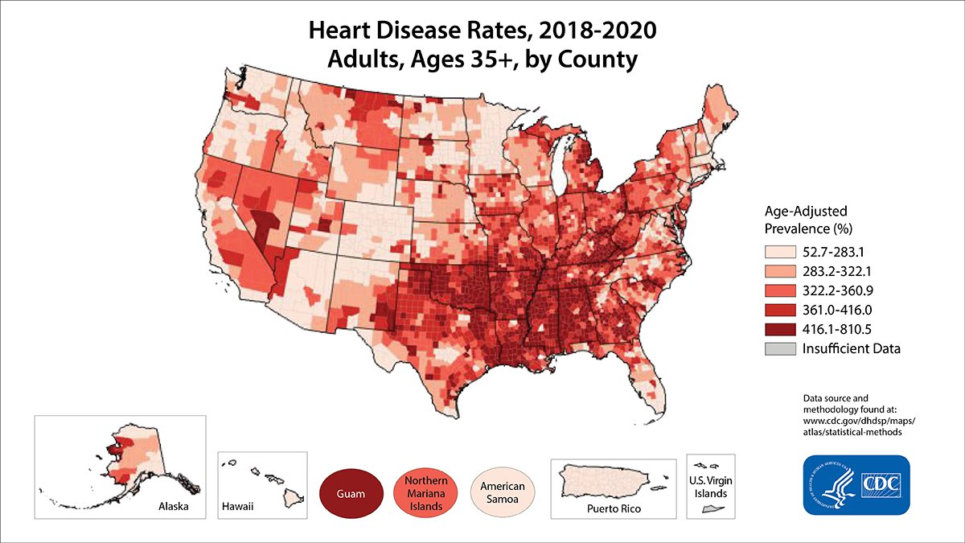
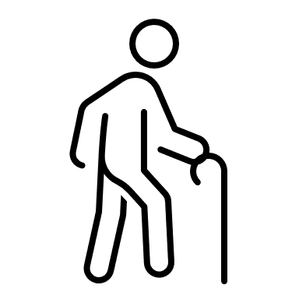
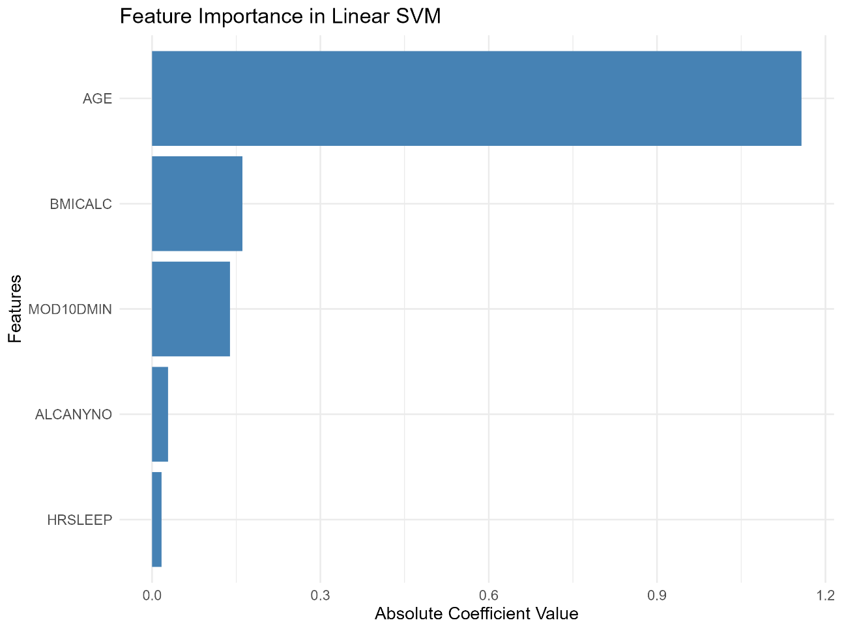
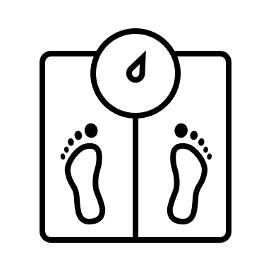


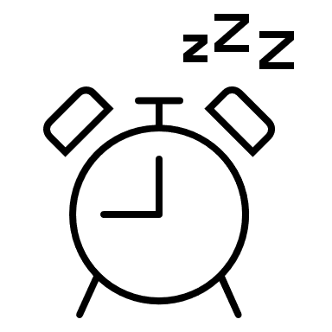
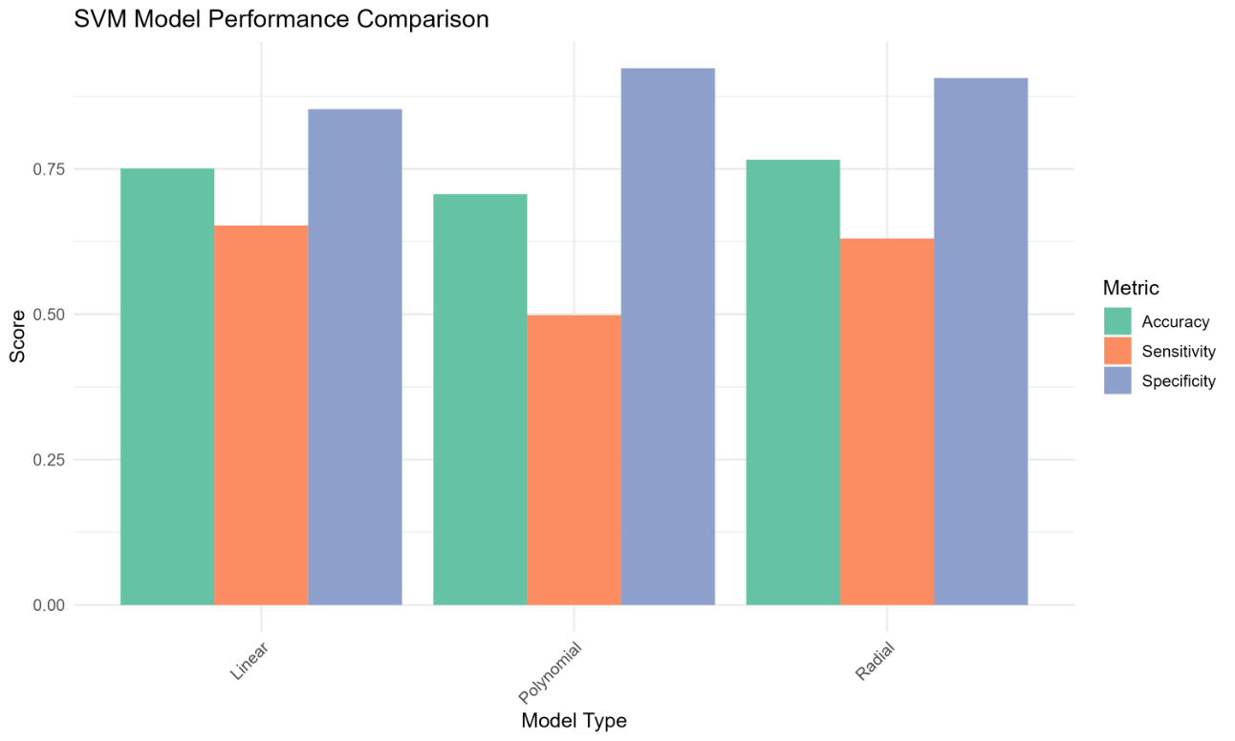
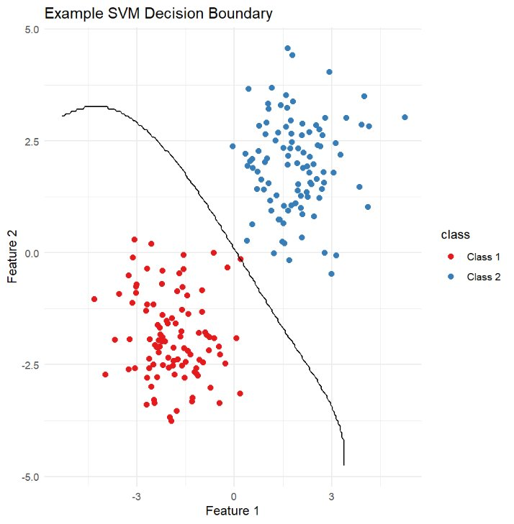
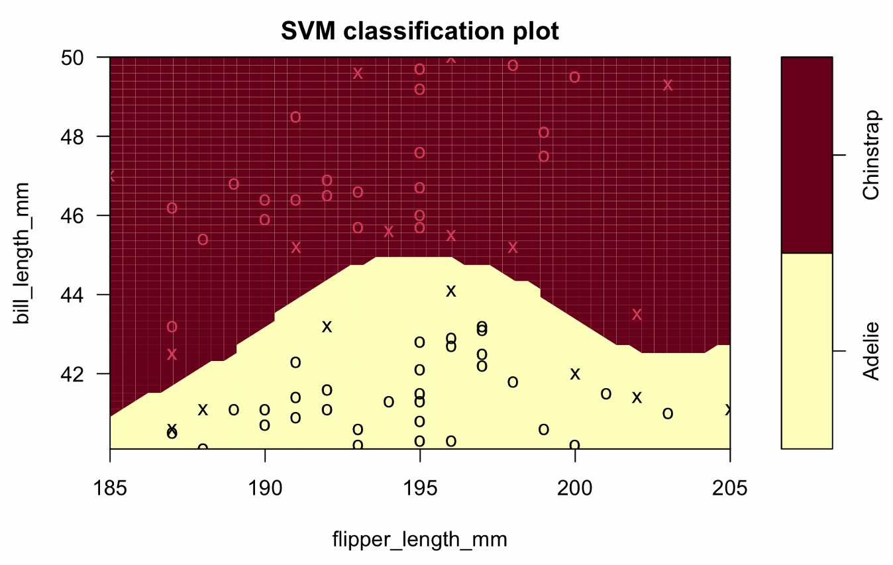

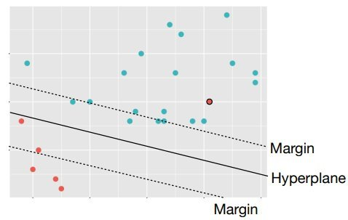
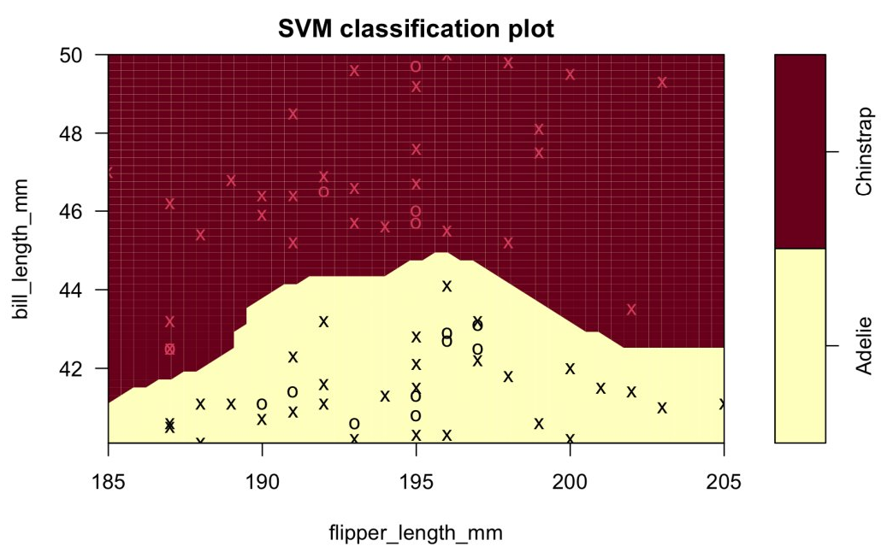
Using Support Vector Machines to Predict Heart Disease By Doga Karabey | Statistical Machine Learning II | April 29, 2025
01 | Introduction
03 | Methodology
04 | Results
Heart disease remains a leading cause of death globally. Predicting risk based on everyday behaviors and demographics could assist prevention efforts.
This study uses the National Health Interview Survey (NHIS) 2022 data to predict the presence of heart disease using Support Vector Machines (SVMs).
Data Handling:
Feature Importance in Linear SVM:
Selected adults (≥18 years) with complete records.
Excluded invalid/missing values based on the NHIS codebook.
Balanced dataset by random under-sampling of the majority class.
Scaled all numeric predictors.
Age
BMI
Features
Moderate Activity
Alcohol Use
Data Description:
48 Variables
Hours of Sleep
Survey Information
Demographic Information
Disease Indicators
Health Metrics & Habits
SVM Model Performance Comparison:
ID numbers, weights; not used in modeling
Age, sex, marital status
Presence of cancer, heart disease, diabetes, heart attack, or stroke
Physical activity, sleep habits, diet, alcohol use
Tuning:
We performed 5-fold cross-validation to tune hyperparameters:
Model Type​ | Parameters Tuned​ | Values Tested​
Linear SVM​ | Cost (C)​ | 0.1, 1, 10​
Radial SVM​ | Cost (C)​ Gamma (γ)​ | C: 0.1, 1, 10 ​ γ: 0.1, 1​
Polynomial SVM​ | Cost (C) ​ Degree (d)​ | C: 0.1, 1 ​ d: 2, 3​
Model​ | Accuracy​ | Sensitivity​ | Specificity​
Linear SVM​ | 75.08%​ | 65.27%​ | 85.28%​
Radial SVM​ | 76.56%​ | 63.02%​ | 90.64%​
Polynomial SVM​ | 70.66%​ | 49.84%​ | 92.31%​
Variable Description: In this project, we focus on predicting self-reported heart disease status based on demographic & health behavior variables, including:
Age
Body Mass Index (BIM)
Weekly moderate Physical Activity Minutes
Sleep Hours per Night
Alcohol Use History
Selected Parameters:
Those are the chosen parameters for each model after the 5-fold cross-validation:
Model Type | Best Cost (C) | Best Gamma (γ)​ | Best Degree (D)​
Linear SVM​ | 1​ | –​ | –​
Radial SVM​ | 1​ | 0.1​ | –​
Polynomial SVM​ | 0.1​ | –​ | 3​
Confusion Matrices:
Model​ | Actual / Predicted​ | No​ | Yes​
Linear SVM​ | No​ | 203​ | 44​
​ | Yes​ | 108​ | 255​
Radial SVM​ | No​ | 196​ | 28​
​ | Yes​ | 115​ | 271​
Polynomial SVM​ | No​ | 155​ | 23​
​ | Yes​ | 156​ | 276​
Model Description: We employ three types of Support Vector Machine (SVM) Models:
01 | Linear Kernel
02 | Radial Basis Function (RBF) Kernel
03 | Polynomial Kernel
02 | Theoretical Background
05 | Discussion
06 | Conclusion
Maximal Margin Classifier​
Example SVM Decision Boundary
Radial Kernel
BMI & age were strong predictors of heart disease presence.
Surprisingly, sleep hours & physical activity had relatively lower feature importance.​
Demographic & lifestyle factors together moderately predict heart disease — but no single factor dominates.
Support vector machines can reasonably predict heart disease based on lifestyle and demographic variables.​
Future work could explore ensemble methods, time-series health data, or incorporating richer behavioral data to improve prediction.
Use case​: Effective when the data is perfectly linearly separable. Only support vectors influence the decision boundary. ​
Advantages​:
Simple and interpretable model.​
Effective for noise-free, linearly separable data.​
Disadvantages​:
Highly sensitive to outliers and noise.​
Inapplicable to overlapping or noisy datasets.​
Approach​: Find the hyperplane that maximizes the distance to the nearest points of any class.​
Ensure that no data points fall inside the margin.​
Use only the support vectors to define the hyperplane.​
Circular boundaries possible​
Far away points matter much less, close together points matter a lot.​
Gamma tuning parameter: ​
Small gamma: larger sphere of influence
Large gamma: smaller sphere of influence ​
Implications:​
Public health policies could prioritize campaigns focusing on weight management and healthy aging to prevent heart disease.​
Alcohol use showed association, suggesting potential for lifestyle interventions.​
Limitations:​
SVMs are black-box models: interpretation is less intuitive than logistic regression.​
Survey-based data may have self-reporting biases.
gamma = 1
07 | Bibliography
Separates two classes (Class 1 and Class 2) using a nonlinear boundary.​
The black curve represents the SVM's optimal decision boundary maximizing the margin between classes.​
IPUMS Health Survey, National Health Interview Survey (NHIS) 2022.​
Centers for Disease Control and Prevention (CDC). (2023). Heart Disease Facts.
gamma = 10

